Slide 1
Software Architecture and Design
Model associations and
other design concerns
Dr. Carlos Eduardo da Silva (c.dasilva@shu.ac.uk)
Department of Computing
College of Business, Technology and Engineering
Sheffield Hallam University

Slide 2
Context and Background
Notes:
Previously seem on the course
- SQL, normalisation and ER diagrams
- no experience in creating code that communicate with databases

Slide 3
Evolution of
Dynamic Web Systems
Going through the layers

Slide 4

A slight detour

Slide 5
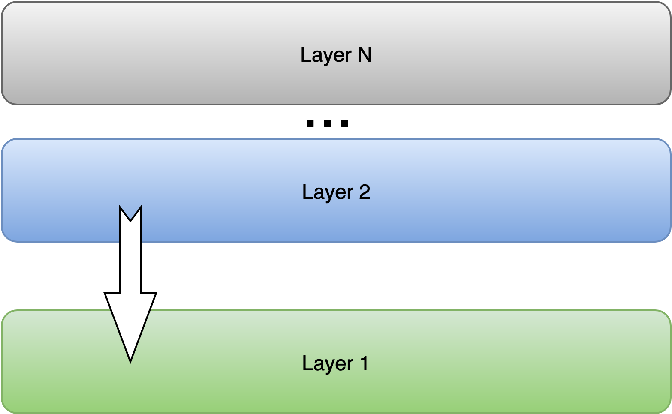
Layers and separation of concerns
A way of structuring a system for grouping functionalities in different levels of abstraction
Upper layers consumes the services from the lower layer
Advantages
Separation of concerns
Complexity is decomposed and encapsulated
Easy to replace
Lower layer present reusable functionality
Favours team development through logical segmentation
Notes:
Works really well when dealing with communication protocols.
Message flows using a protocol suite. Black loops show the actual messaging loops, red loops are the effective communication between layers enabled by the lower layers.

Slide 6
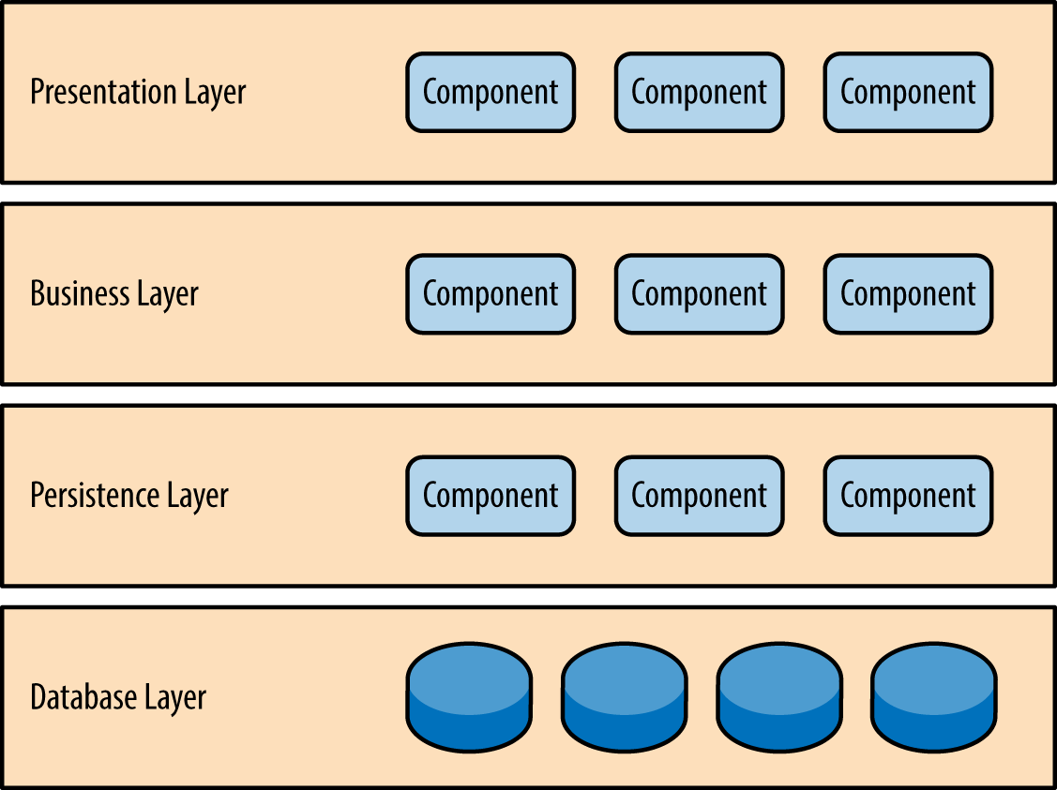
Layers and separation of concerns
Layers in Software
Grouping of classes (OO)
Or subsystems
Upper consumes lower
Usually 3 layers
Layers can be distributed
https://www.oreilly.com/library/view/software-architecture-patterns/9781491971437/ch01.html
Notes:
Usually done in 3 layers:
\begin{itemize}
\item Presentation layer: user interface
\item Business layer: business rules
\item Service (data, persistence) layer: application independent general purpose objects. Ex: access to database and other systems
\end{itemize}

Slide 7
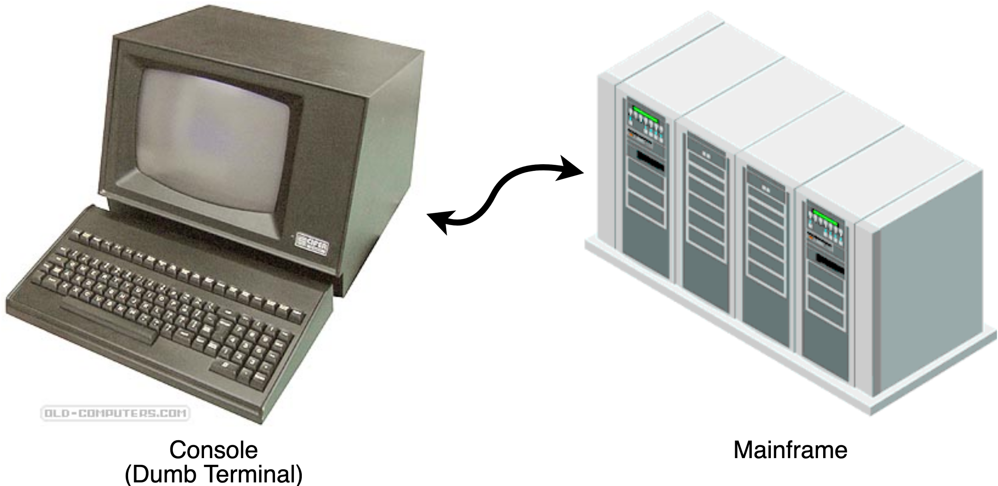
Evolution of Enterprise Systems
Single-tier (Mainframe)
Dumb terminals
Terminals/consoles with text interface
Mainframe
Entire application in a single physical host
Notes:
Dumb terminals with text interface
Mainframe: entire application in a single physical host

Slide 8
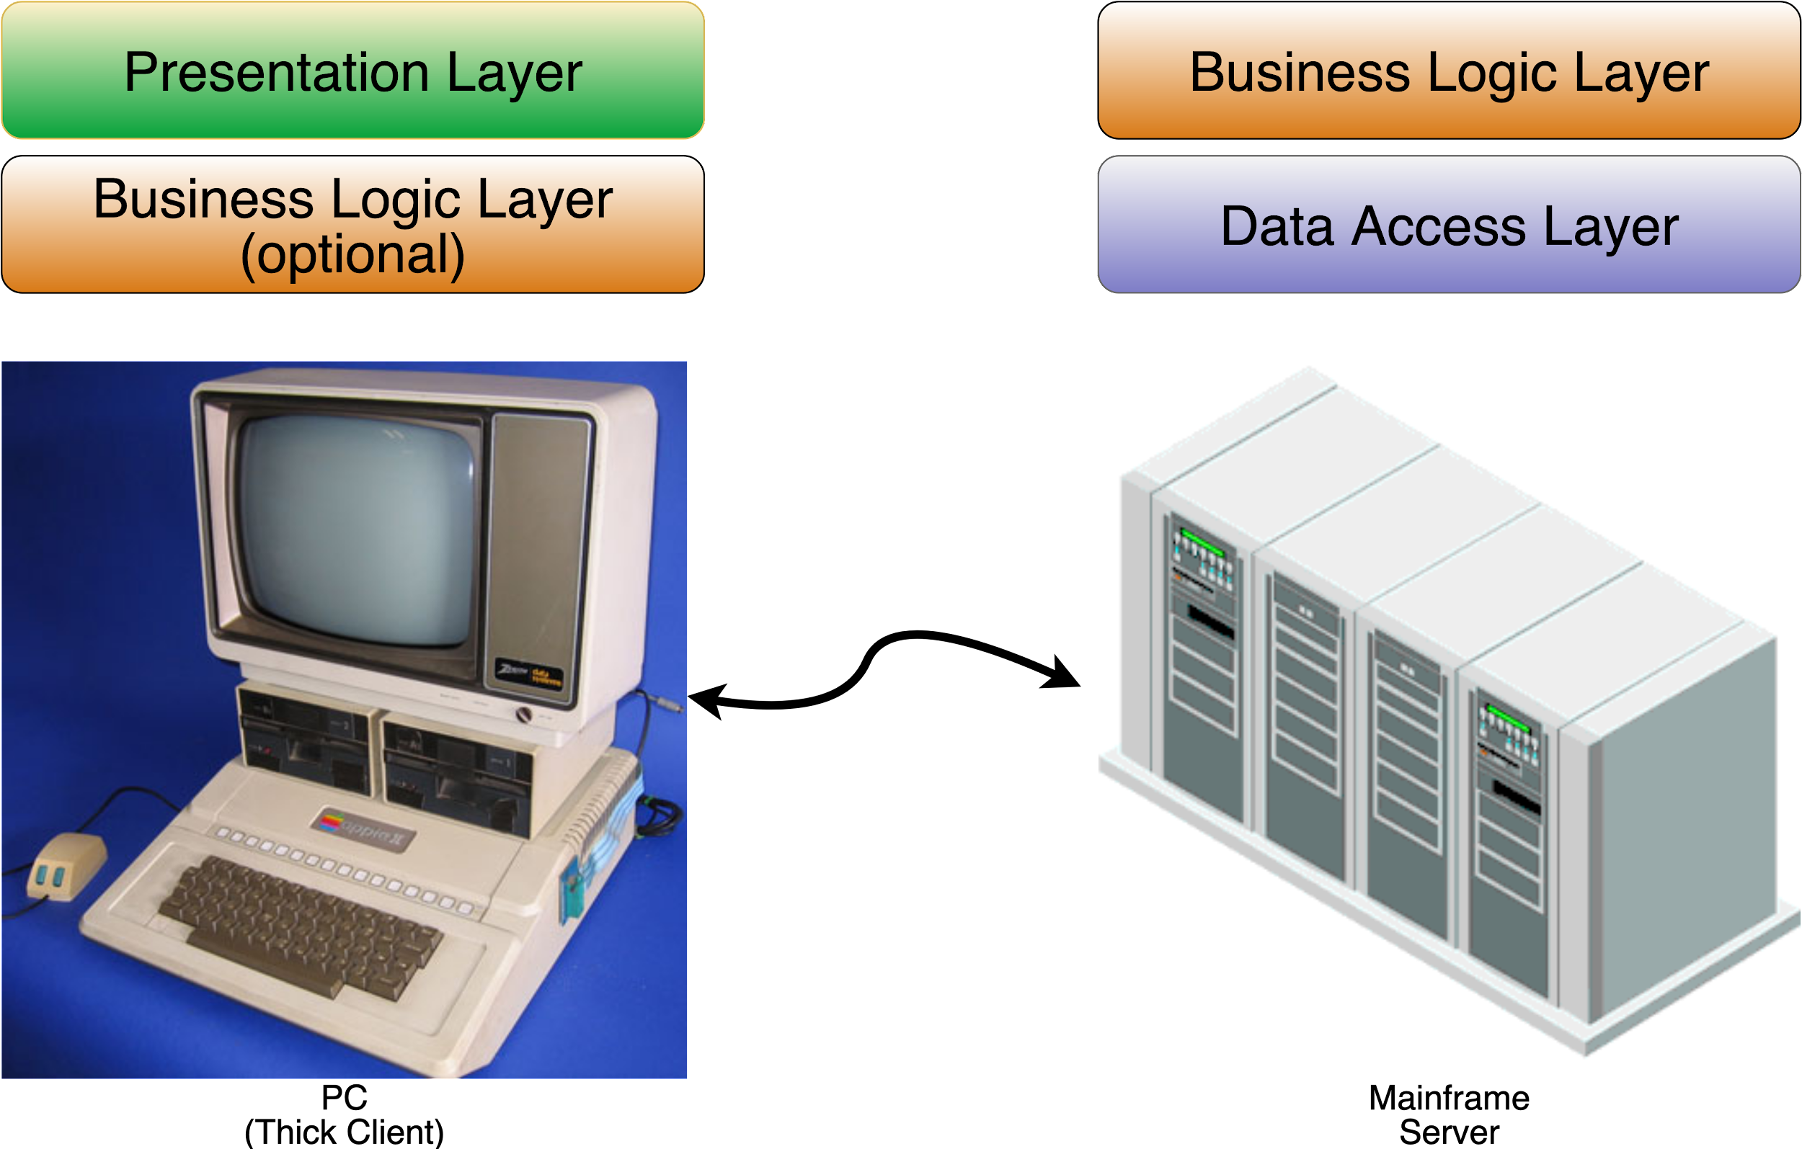
Evolution of Enterprise Systems
Two-tier (Client-Server)
Notes:
Popularization of PC during the 80s
Mainframe server: Business logic and data
Thick client
More powerful than dumb terminals
GUI and data validation
Small variation: some business logic in the client

Slide 9
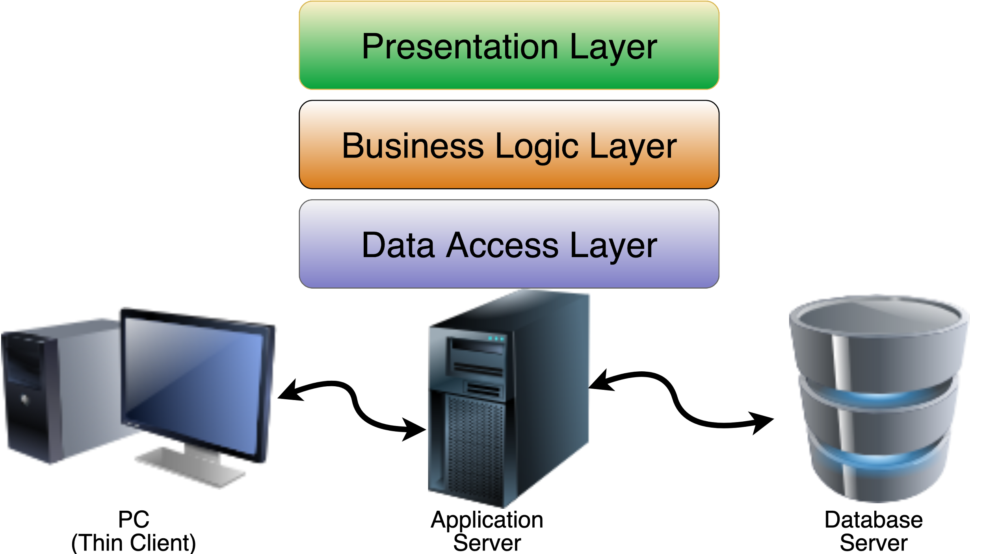
Evolution of Enterprise Systems
Three-tier (Web interfaces)
1990s
Notes:
Thin client: Web browser
Application server: At the beginning everything was mixed together.

Slide 10
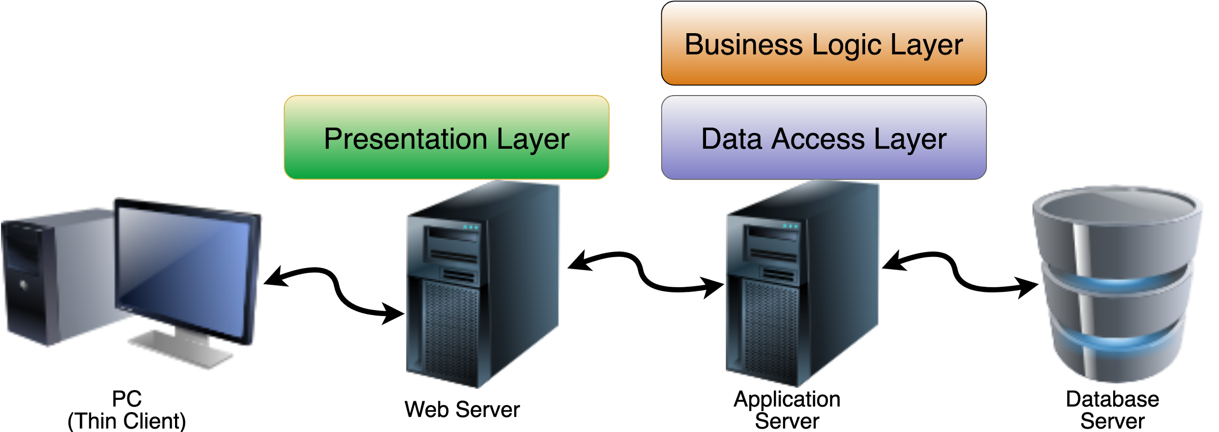
Evolution of Enterprise Systems
N-tier (Multi-layers)
Notes:
Presentation was separated from the others
Components:
Thin Client: Web browser (no code running on client)
Web server: Presentation logic
Application Server: Business Logic and data access
Database server
Layers: usually 3 layers
Presentation layer: User interface
Business layer: application logic and domain objects (model)
Data access layer (service, persistence): general purpose objects, Application independent. Ex: acess to database/other systems

Slide 11
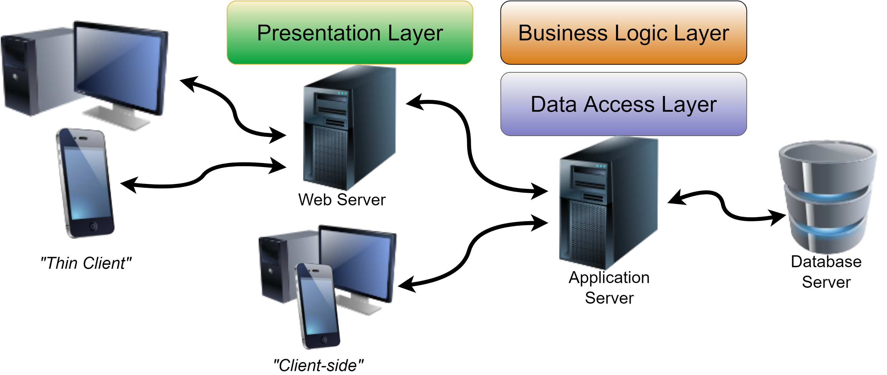
Evolution of Enterprise Systems
N-tier (Multi-layers)
Notes:
Components:
Thin Client: Web browser rendering HTML
Client-side: Active code running on client computer (React/Vue), direct access to API at back-end
Web server: Presentation logic (Serves code that will run client-side and/or returns HTML page)
Application Server: Business Logic and data access
Database server
Layers: usually 3 layers
Presentation layer: User interface
Business layer: application logic and domain objects (model)
Data access layer (service, persistence): general purpose objects, Application independent. Ex: acess to database/other systems

Slide 12
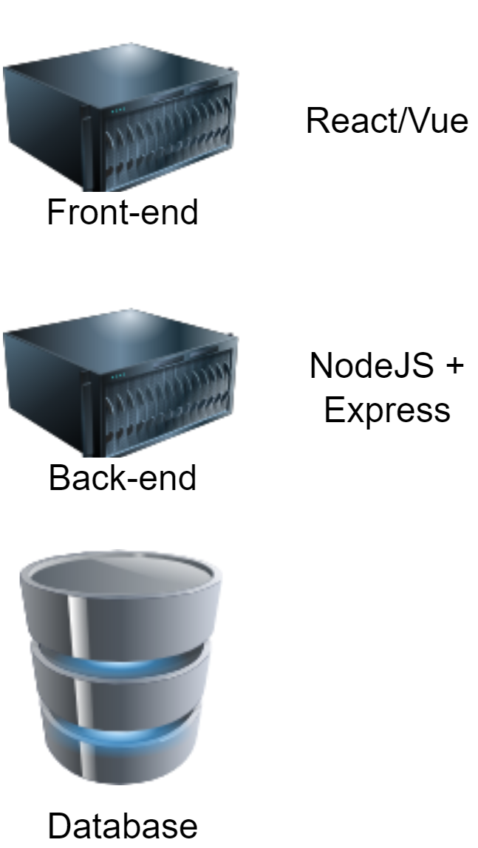
Evolution of Web Applications
A Web application can be:
Oriented to presentation
Interactive Web pages
Mark-up Language: HTML, XHTML, XML
Dynamic content
Oriented to services
Web service Endpoint
Our client is the previous type
SOAP, REST, ...

Slide 13
Evolution of Web Applications
Static content
HTML
Dynamic content
External to server: CGI
Extension to server: Servlets
Dynamic pages (Templates): PHP, ASP, JSP/JSF

Slide 14
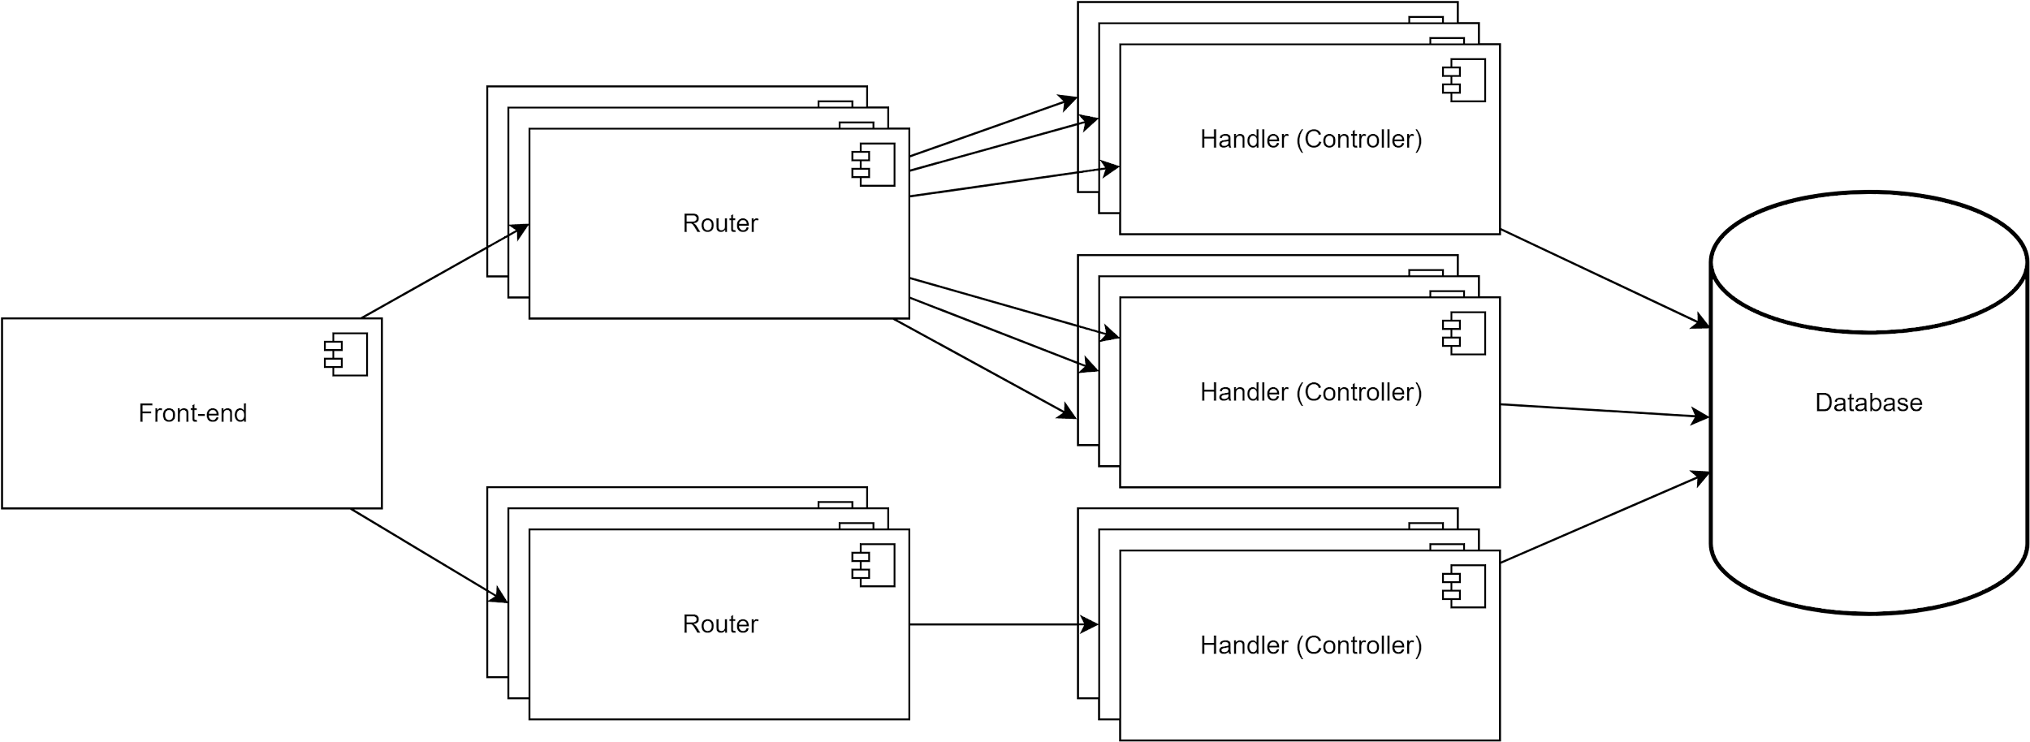
Dynamic Web Pages with DB
Notes:
So far we have explored

Slide 15
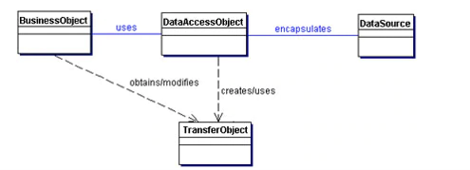
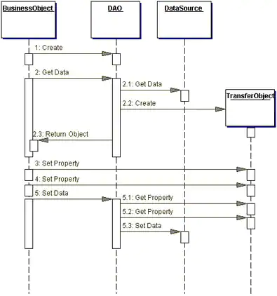
Remember the Data Access Object
https://www.oracle.com/java/technologies/dataaccessobject.html
Notes:
Sequence diagram
2. Retrieve: operation #2
3. Update: operations #3, #4, #5

Slide 16
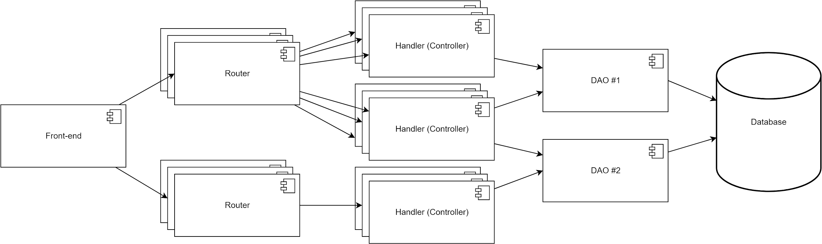
Dynamic Web Pages with DB
Now with the DAO
Notes:
Dynamic Web application with database access would have database related code in all of its controllers.
What happens when you change the actual database (e.g., mysql x postgresql x mongodb x other)?
What happens when there is a change in your data structure?

Slide 17

Any questions?
Photo by Simon Hurry on Unsplash

Slide 18
An (brief) introduction to ORM/ODM
Notes:
- the Impedance problem
- ORM to the rescue
- Hybernate
- EF
- Reinforce the idea of OO classes instead of ER diagrams

Slide 19
Introduction to O/R mapping
Several technologies used for development
Object orientation: Java, C#, …
Relational databases: MySql, PostgreSQL
Impedance problem
Different paradigms: Object x Relational
Classes/Object vs Tables/Lines
Developer needs to deal with
Data translation, database access
Enters O/R mapping
Technique for type system conversion
Objects model <-> Relational scheme
Transparent persistence
Java: Hibernate, JPA; .Net: Entity Framework; NodeJS: Sequelize, Mongoose
Notes:
Technologies
SQL: Well-known language with several tools for managing/processing of data
Other technologies: COBOL/Fortran, Object-oriented databases, NoSQL, GIS
Impedance problem
OO: software engineering principles
Relational: mathematical principles (relational algebra)
We still have different SQL dialects based on the product
Requires more code to deal with database
More code leads to more chances of errors
OR mapping
Programmer abstracts away from SQL
Independence from databases products and dialects
Several tools available: Java (Hibernate, Castor, Torque, JPA), .Net (Entity Framework), JavaScript (sequelize, mongoose).

Slide 20
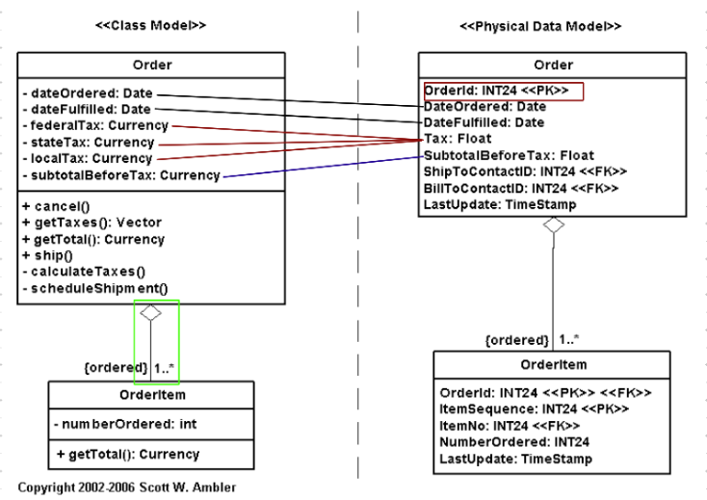
Introduction to O/R mapping
Notes:
Translation rules
Classes to Tables
Instances to lines/entries
Attributes to columns
Not straightforward
Not all class attributes are represented by columns in the table
Attributes to zero or more columns: non-persistent attributes; name surname; total of shopping trolley
Different data type: Semantics, size (max value)
Shadow Information: Objects need information about database values (beyond domain): IDs, creation/update date

Slide 21
A recap on ODM (Mongoose)

Slide 22
Mongoose
Object-document mapper
Object-Relationship Mapping
Define models through schemas
What type of data can be saved
Model
A class for a JavaScript object
Used to organise database queries
Schema
A blueprint for your objects
Think of a class definition
Use
npm install mongoose
Model
Schema
Validators
Functions

Slide 23
Example with pet
propertyName : { type: String, required: true, unique: true }
Mongoose provides helper functions
Animal.save()
Animal.find()
Animal.findById(_id)
Animal.findByIdAndUpdate(_id, {new document})
Animal.findByIdAndRemove(_id)
module.exports = mongoose => {
var schema = mongoose.Schema(
{
name: String,
species: String,
breed: String,
age: Number,
colour: String
}
);
const Animal = mongoose.model("animal", schema);
return Animal;
}
const db = require("../models");
const Animal = db.animals;
exports.create = (req, res) => {
// Create a Animal model object
const animal = new Animal({
name: req.body.name, //...
});
// Save Animal in the database
animal.save().then(data => { //...
})//...
Notes:
An example of schema including validators (the types for each attribute).
The mongoose model is equivalent to the DAO…

Slide 24
Example with pet
This is the mongoose model
This is our controller
This is the MongoDB database
propertyName : { type: String, required: true, unique: true }
module.exports = mongoose => {
var schema = mongoose.Schema(
{
name: String,
species: String,
breed: String,
age: Number,
colour: String
}
);
const Animal = mongoose.model("animal", schema);
return Animal;
}
const db = require("../models");
const Animal = db.animals;
exports.create = (req, res) => {
// Create a Animal model object
const animal = new Animal({
name: req.body.name, //...
});
// Save Animal in the database
animal.save().then(data => { //...
})//...
Notes:
An example of schema including validators (the types for each attribute).
The mongoose model is equivalent to the DAO…

Slide 25

End of recap
Any questions?

Slide 26
Enters association
Notes:
- Enters association
- Explanation of what is an association (reflect back to SQL relations)
- Types of assocations: 1x1, 1xN, Nx1, NxN
- Reflect back to how it was done in SQL and how it is in mongoose

Slide 27
Model Associations
Model Associations – relationships between documents
The following are the relationships:
One-to-one – one model has an association with another model
One Student can have only one Scholarship
One-to-many – one model has many associations with another model, but other model has only one association with the other model
One Academic Adviser can advise multiple Students
Many-to-many – Many instances of one model has multiple associations to another model and vice versa
A Course is compose of several Modules, and a Module can be taught on several Courses

Slide 28
Model Association in Mongoose
Association added via a property with the associated model’s name
course: { type: Schema.Types.ObjectId, ref: "Course" }
Where:
course – is the property
ObjectId – is the type
ref – attribute to set model’s name

Slide 29
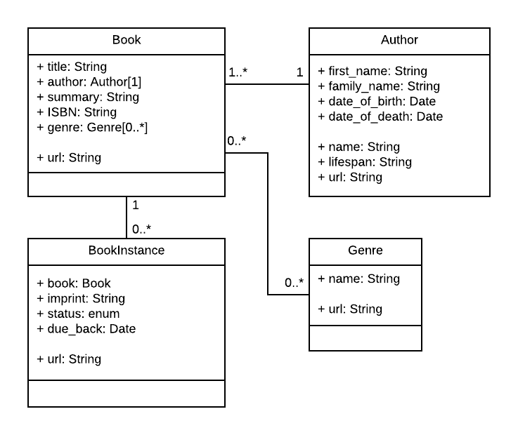
A Library Model
Example from https://developer.mozilla.org/en-US/docs/Learn/Server-side/Express_Nodejs/mongoose
Notes:
- Explanation of what is an association (reflect back to SQL relations)
- Types of assocations: 1x1, 1xN, Nx1, NxN
- Reflect back to how it was done in SQL and how it is in mongoose

Slide 30
A Library Model
This is a domain model
Classes/objects for each “concept/entity”
Library
Books and their information
Authors might have written several books
Multiple copies (BookInstance)
Relationships between entities
UML associations are enough
Multiplicities
A book always have a single author
Example from https://developer.mozilla.org/en-US/docs/Learn/Server-side/Express_Nodejs/mongoose

Slide 31
A Library Model
Creating the mongoose model
One file/module per entity
/models
author.js
book.js
bookinstance.js
genre.js
Example from https://developer.mozilla.org/en-US/docs/Learn/Server-side/Express_Nodejs/mongoose

Slide 32
A Library Model
const AuthorSchema = new Schema({
first_name: { type: String, required: true, maxLength: 100 },
family_name: { type: String, required: true, maxLength: 100 },
date_of_birth: { type: Date },
date_of_death: { type: Date },
});
//...
// Export model
module.exports = mongoose.model("Author", AuthorSchema);
Example from https://developer.mozilla.org/en-US/docs/Learn/Server-side/Express_Nodejs/mongoose

Slide 33
A Library Model
const AuthorSchema = new Schema({
first_name: { type: String, required: true, maxLength: 100 },
family_name: { type: String, required: true, maxLength: 100 },
date_of_birth: { type: Date },
date_of_death: { type: Date },
});
//...
// Export model
module.exports = mongoose.model("Author", AuthorSchema);
const BookSchema = new Schema({
title: { type: String, required: true },
author: { type: Schema.Types.ObjectId, ref: "Author", required: true },
summary: { type: String, required: true },
isbn: { type: String, required: true },
genre: [{ type: Schema.Types.ObjectId, ref: "Genre" }],
});
// Export model
module.exports = mongoose.model("Book", BookSchema);
Example from https://developer.mozilla.org/en-US/docs/Learn/Server-side/Express_Nodejs/mongoose

Slide 34
A Library Model
const BookInstanceSchema = new Schema({
book: { type: Schema.Types.ObjectId, ref: "Book", required: true },
imprint: { type: String, required: true },
status: {
type: String, required: true,
enum: ["Available", "Maintenance", "Loaned", "Reserved"],
default: "Maintenance",
},
due_back: { type: Date, default: Date.now },
});
// Export model
module.exports = mongoose.model("BookInstance", BookInstanceSchema);
const BookSchema = new Schema({
title: { type: String, required: true },
author: { type: Schema.Types.ObjectId, ref: "Author", required: true },
summary: { type: String, required: true },
isbn: { type: String, required: true },
genre: [{ type: Schema.Types.ObjectId, ref: "Genre" }],
});
// Export model
module.exports = mongoose.model("Book", BookSchema);
Example from https://developer.mozilla.org/en-US/docs/Learn/Server-side/Express_Nodejs/mongoose

Slide 35
Some considerations
const Comment = mongoose.model(
"Comment",
new mongoose.Schema({
username: String,
text: String,
createdAt: Date
})
);
module.exports = Comment;
Remember that you have to deal with two or more collections when creating a document
The same is valid for when deleting a document
const createComment = function(tutorialId, comment) {
return db.Comment.create(comment).then(docComment => {
console.log("\n>> Created Comment:\n", docComment);
return db.Tutorial.findByIdAndUpdate(
tutorialId,
{ $push: { comments: docComment._id } },
{ new: true, useFindAndModify: false }
);
});
};
const Tutorial = mongoose.model("Tutorial",
new mongoose.Schema({
title: String, author: String, images: [],
comments: [
{
type: mongoose.Schema.Types.ObjectId,
ref: "Comment"
}]
})
);
module.exports = Tutorial;
Example from https://www.bezkoder.com/mongoose-one-to-many-relationship/

Slide 36
Some considerations
const Comment = mongoose.model(
"Comment",
new mongoose.Schema({
username: String,
text: String,
createdAt: Date
})
);
module.exports = Comment;
… the same is valid for retrieving documents
const getTutorialWithPopulate = function(id) {
return db.Tutorial.findById(id).populate("comments");
};
const getTutorial = function(id) {
return db.Tutorial.findById(id);
};
const Tutorial = mongoose.model("Tutorial",
new mongoose.Schema({
title: String, author: String, images: [],
comments: [
{
type: mongoose.Schema.Types.ObjectId,
ref: "Comment"
}]
})
);
module.exports = Tutorial;
Example from https://www.bezkoder.com/mongoose-one-to-many-relationship/

Slide 37


Slide 38
Some design implications
Notes:
- Links with design implications
- Present the notion of business objects
- DAOs by themselves are not enough
- Some business functions might require more than one read/write in a database

Slide 39
Getting back to the layers
Front-end
Vue/React
Back-end
NodeJS/Express
MongoDB

Slide 40
Some considerations
const Comment = mongoose.model(
"Comment",
new mongoose.Schema({
username: String,
text: String,
createdAt: Date
})
);
module.exports = Comment;
Remember that you have to deal with two or more collections when creating a document
The same is valid for when deleting a document
const createComment = function(tutorialId, comment) {
return db.Comment.create(comment).then(docComment => {
console.log("\n>> Created Comment:\n", docComment);
return db.Tutorial.findByIdAndUpdate(
tutorialId,
{ $push: { comments: docComment._id } },
{ new: true, useFindAndModify: false }
);
});
};
const Tutorial = mongoose.model("Tutorial",
new mongoose.Schema({
title: String, author: String, images: [],
comments: [
{
type: mongoose.Schema.Types.ObjectId,
ref: "Comment"
}]
})
);
module.exports = Tutorial;
Example from https://www.bezkoder.com/mongoose-one-to-many-relationship/
Notes:
How many operations are happening from the point of view of the Business logic and Database?
1 and 1;
1 and 2;
2 and 2;
2 and 1;

Slide 41
Getting back to the layers
Front-end
Vue/React
Routers/ Controllers
Back-end
NodeJS/Express
MongoDB
Notes:
Explicit introduction of routers/controllers. Those components deal with communication protocol (REST) related things and should not be involved in business functions.

Slide 42
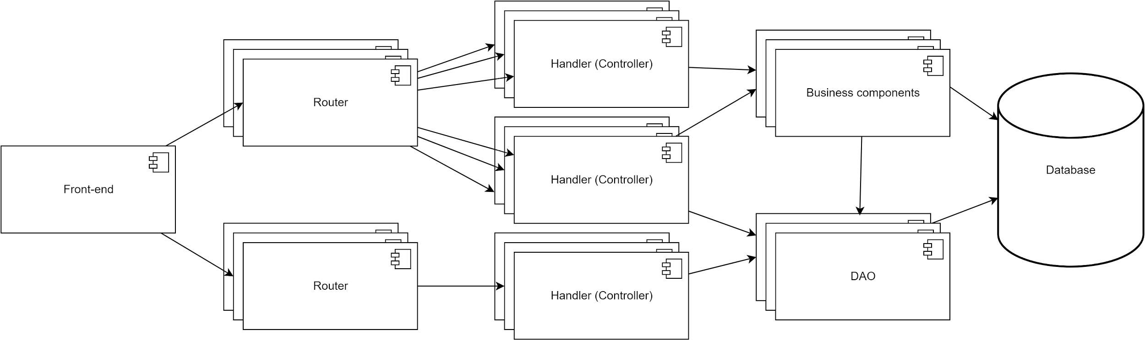
Getting back to the layers
… now we also have business components
Separate specific business logic from controller logic
Notes:
If your back-end now communicates using a publish-subscribe (mqtt) middleware, you would only need to change the router/controller for the appropriate technology, and not needed to touch any of the business logic.

Slide 43
Getting back to the layers
Front-end
Vue/React
Routers/ Controllers
Domain model
Back-end
NodeJS/Express
MongoDB

Slide 44
Going back to the DAO
Front-end
Routers/controllers
Form + submission (CRUD)
Services
Deals with connection to back-end
Domain models
Represent the domain entities
Back-end
Routers/controllers
Point to the right business component
Business components
DAOs
Domain models
This is the domain model

Slide 45


Slide 46
References
Express Tutorial Part 3: Using a Database (with Mongoose) <https://developer.mozilla.org/en-US/docs/Learn/Server-side/Express_Nodejs/mongoose>
BezKoder. MongoDB One-to-One relationship tutorial with Mongoose example <https://www.bezkoder.com/mongoose-one-to-one-relationship-example/>
BezKoder. MongoDB One-to-Many Relationship tutorial with Mongoose examples <https://www.bezkoder.com/mongoose-one-to-many-relationship/>
BezKoder. MongoDB Many-to-Many Relationship with Mongoose examples <https://www.bezkoder.com/mongodb-many-to-many-mongoose/>

